Slide 1
Economic Outlook and Government Investment in India
(A Look into the Next Three Years)

Slide 2

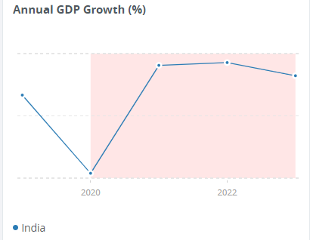
Introduction:
Brief overview of the current economic scenario in India
The overall growth remains robust and is estimated to be 6.9
percent for the full year with real GDP growing 7.7 percent
year-on-year during the first three quarters of fiscal year2022/23
Nearly 70% of India's GDP is driven by domestic consumption
country remains the world's fourth-largest consumer market.
Apart from private consumption, India's GDP is also fueled by
government spending, investments, and exports. In 2022,
India was the world's 8th-largest importer and the 10th-largest
exporter.

Slide 3
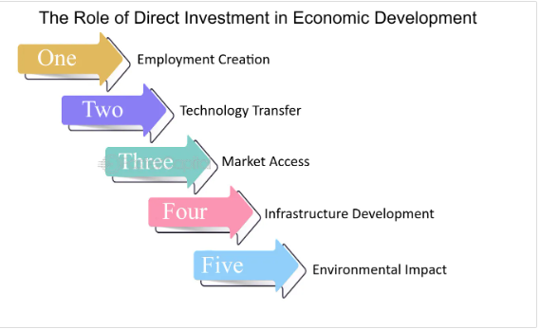
Importance of government investment in economic development
Infrastructure Development
Human Capital Development
Research and Development (R&D)
Industry Support
Stabilization Policies
Public Goods Provision

Slide 4
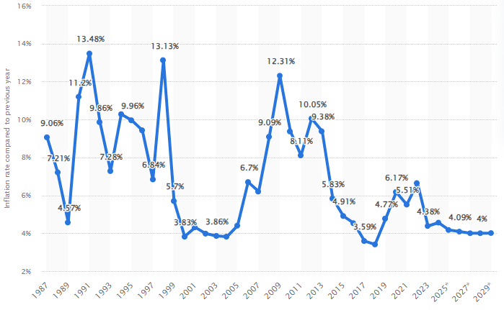
Macroeconomic overview-Macroeconomics focuses on the performance of economies – changes in economic output, inflation, interest and foreign exchange rates, and the balance of payments
Inflation Rate:

Slide 5
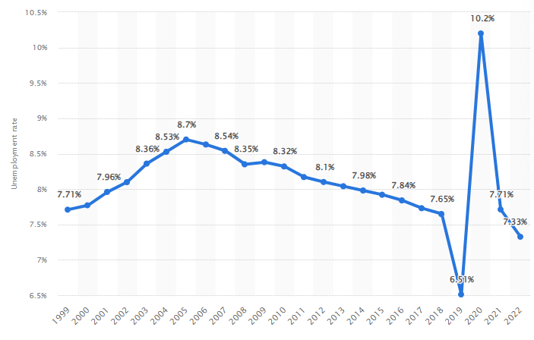
Unemployement Rate:

Slide 6
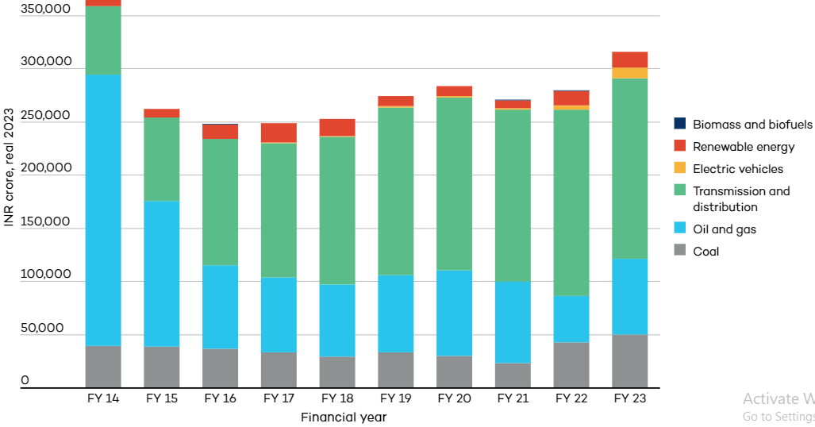
Subsidy Reforms: a measure that keeps. prices for consumers below market levels,
or keeps prices for producers above market levels or that reduces.

Slide 7
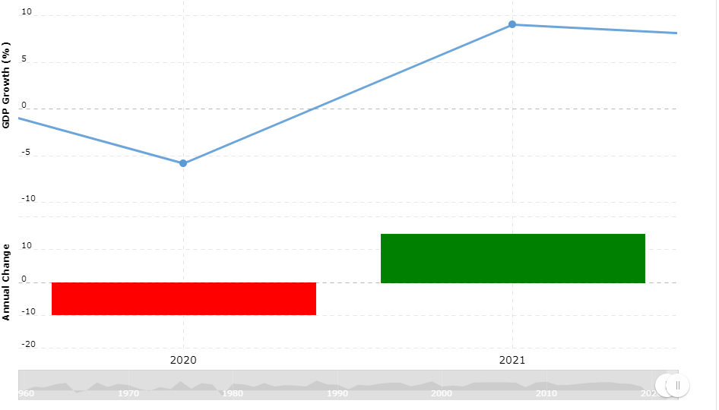
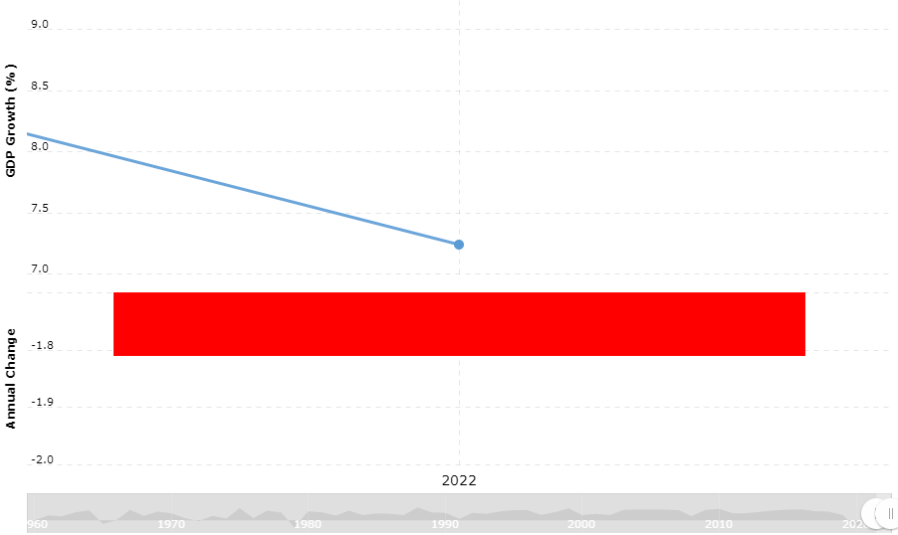
GDP Comparison of previous Years:

Slide 8
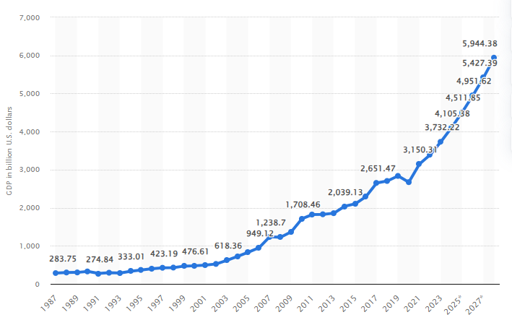
Economic Situation of India in the future 3 years:
India will be third largest economy in by 2027.
Over the last 10 years, India’s GDP has grown by 7% CAGR in USD terms to $3.6 trillion - jumping from the 8th
largest to the 5th largest economy. Over the next 4 years, India’s GDP will likely touch $5 trillion, making it the3rd
largest economy by 2027, overtaking Japan and Germany, being the fastest growing large economy with the tailwinds
of demographics.

Slide 9
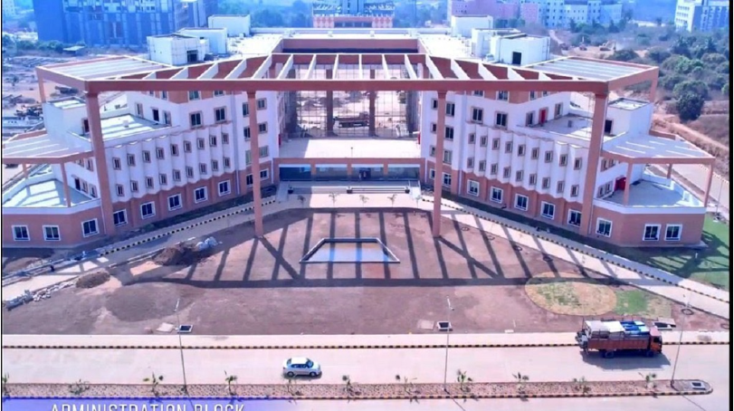
Completed Projects
Government Investment of projects (State project)
IIT DHARWAD:
Sector: Education infrastructure
State: Karnataka
Project start date: 21 may 2020
Completion date: 20 sep 2023
Ministry: Department of higher
Education
Project Type: University Infrastructure
Land Area: 190.85 hectares
Ticket Site: 1062.83 Inr crores
Sub Con: B.G Shirke Construction
Technology PVT.LTD

Slide 10
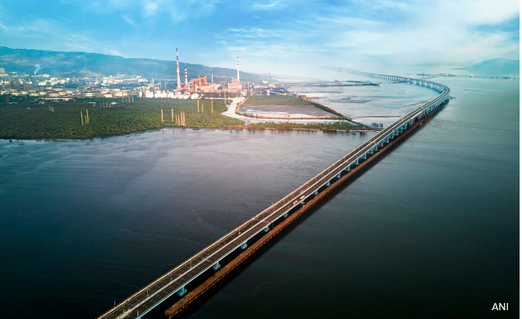
Mumbai Trans Harbour Link(State project)
Project Name: Atal Setu
Sector: Highways
Sub Sector: Roads & Bridges
State: Maharashtra
Project Date: 23 mar 2018
Completion Date: 31 dec 2023
Sub Con: Larsen & Tourbro(L&T)
Ministry: Ministry of housing
and urban affairs
Project Capacity: 22.0 kilometre
Land Area: 108.44 hectares
Ticket Size: 17843 inr crores

Slide 11
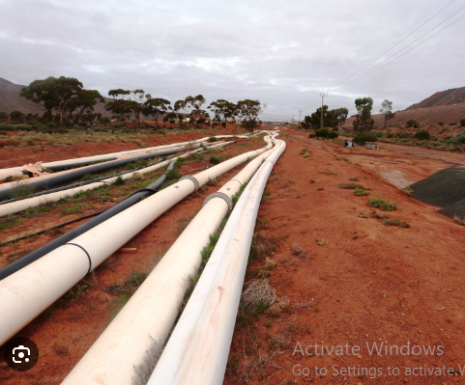
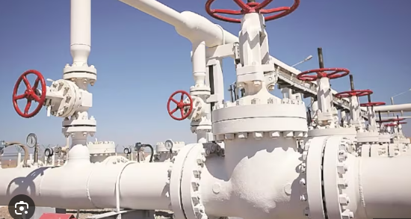
Extension of Paradip - Haldia - Durgapur LPG Pipeline(State project)
Project Name: Durgapur Lpg pipeline
Sector: Oil/gas/lng storage
State: Jharkand,Bihar
Project Date: 29 jan 2015
Completion Date: 28 feb 2023
Sub Con: Indian Oil
Line Ministry: Ministry of petroleum & natural gas
Project capacity: 917 kilometer
Ticket Size: 3027.9 Inr Crores
Augmentation Of Paradip - Haldia - Durgapur LPG Pipeline And Its Extension Up To Patna And Muzaffarpur

Slide 12
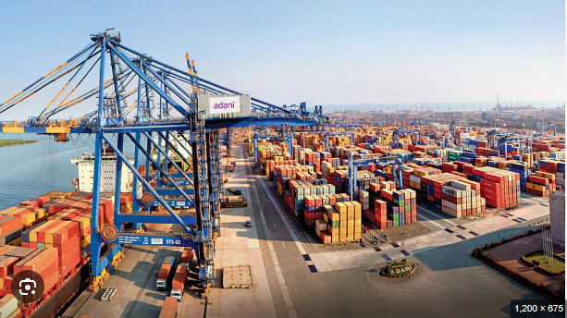
Haldia Dock Complex Terminal 2(National Project)
Project Name: Haldia Dock Complex
Sector: Shipping
Sub sectors: Ports
State: West Bengal
Project Date: 05 sep 2019
Completion Date: 01 apr 2022
Ministry: Ministry of Ports,shipping
and waterways
Project Capacity: 2.0 million tons
Sub Con: Adani Group
Ticket size: 90.35 Inr Crores
It is constructed on the Hooghly river upstream to handle the liquid cargo like edible oil viz.
vegetable oil, soya oil, palmolein oil etc. and paraxylene and other chemicals.

Slide 13
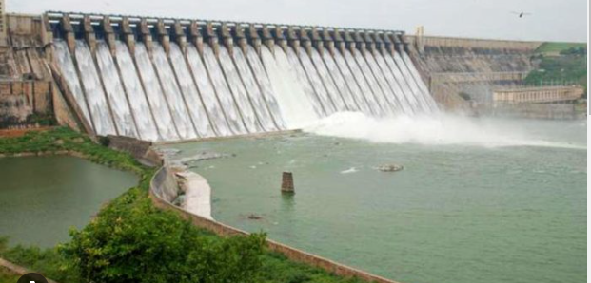
Upcoming Projects
Water Suppy For Strengthening and Rehabilitation (State project)
Project Name: Chambal Bhilwara project
Sector: Water & Waste
State: Rajasthan
Sub sectors: Water treatment Plants
Project Date: 01 Jul 2023
Completion Date: 15 Jun 2025
Ministry: Department of Drinking water
and Sanitation
Project Capacity: 34.28 mld(megaliters per day)
Sub con: GVPR Engineers Limited
Project Scheme: Jal Jeevan Mission
Land Area: 195000 square meter
Ticket Size: 1082.07 inr Crores

Slide 14
The Chambal River flows primarily through the states of Rajasthan, Madhya Pradesh, and Uttar Pradesh in northern India. The Chambal Bhilwara project focuses on utilizing the water resources of the Chambal River basin, particularly in the Bhilwara district of Rajasthan.
One of the primary purposes of the Chambal Bhilwara project is to create irrigation infrastructure to support agriculture in the region. This involves constructing dams, reservoirs, canals, and lift irrigation systems to facilitate the controlled distribution of water to agricultural lands.
To solve the drinking water problem in Bhilwara district, water supply project for Bhilwara town, 8 other urban towns & 1688 villages of Bhilwara district has been proposed taking Chambal River as a sustainable source of water. Proposed location of source is near Bhainsroadgarh on upstream of Jawahar Sagar Dam. Proposed site of Intake well is about 122Km from Bhilwara town.

Slide 15
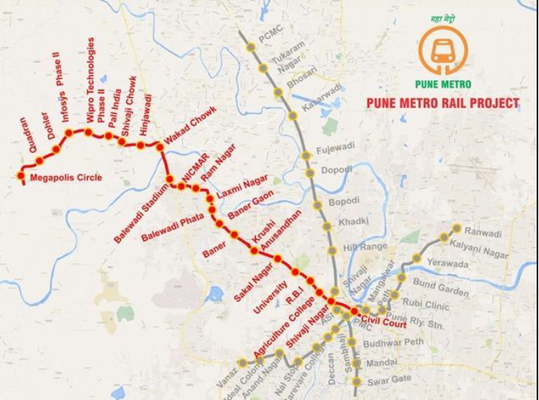
METRO LINE-3
Project Name: PUNE METRO LINE-3 Hinjawadi – Shivajinagar(Puneri Metro)
Sector: Urban Public transport
State: Maharashtra
Project Date: 21 Sep 2019
Completion Date: 25 Mar 2026
Project Capacity: 23.2 Km
Land Area: 27.84 hectares
Ticket Size: 8313 inr Crores
Developed by: Pune Metropolitan Region
Development Authority (PMRDA)

Slide 16
23.3 km Pune Metro Line-3 will connect Hinjewadi with Shivajinagar’s Civil Court through 23 elevated stations by a Special Purpose Vehicle named Pune IT City Metro Rail Limited.
This line was approved by Mahrashtra’s state government on February 9 2018 for implementation on the public-private partnership (PPP) model on design, build, finance, operate and transfer (DBFOT) basis with a budget of Rs 8,100 crore.
The Government of India on March 7, 2018 granted in-principle approval for providing 20% Viability Gap Funding (VGF). Contribution of Maharashtra State Government’s VGF amount was approved in the form of land transfer from various state agencies
It includes a wide range of specialized equipment and tools to carry out various tasks involved in building the metro infrastructure. a general overview of the machinery commonly used
Tunnel Boring Machines
Excavators and Loaders
Concrete Mixers and Pump Trucks
Cranes
Piling Rigs
Utility Vehicles and Trucks

Slide 17
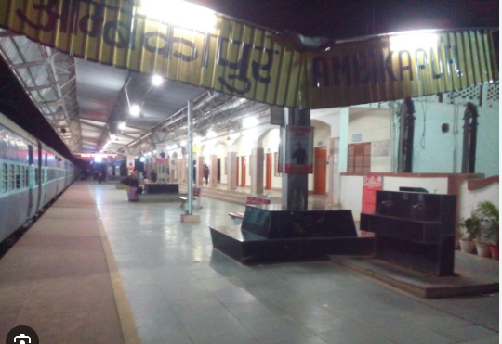
Ambikapur Railway Track(State project)
Project name: DOUBLING OF BORIDAND - AMBIKAPUR ( SURAJPUR)
Sector: Railways
State: Chhattisgarh
Project Start Date: 05 Apr 2022
Completion Date: 30 Mar 2026
Ministry: Ministry of Railways
Track/Section length: 118.81 Km
Land area: 6.5 hectares
Ticket Size: 775.47 inr Crores
This project in Railway Track sub-sector involves Doubling/
Electrification/Maintenance of Existing Track.
By doubling traffic capacity will increase alongwith upgradation
of social activties of area.The loading and transportation of coal
for power plants will increase.
Improved rail connectivity can stimulate economic growth by
facilitating the movement of goods and people. It can attract
investment, promote trade, and create employment opportunities in the region served by the railway line.

Slide 18
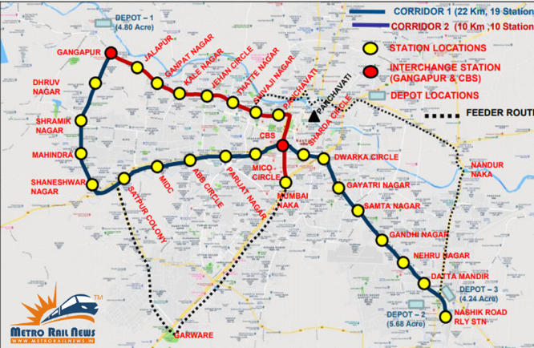
Metro Project
Project Name: Nashik MetroNeo Project
Sector: Urban Public Transport
State: Maharashtra
Project Date: 01 Jan 2022
Completion Date: Dec 2027
Project Capacity: 33.0 Km
Ticket Size: 2092.22 inr Crores
Metro Neo is an innovative transport system, which will be implemented for the first time in India in Nasik by Maha Metro. The detailed project report (DPR), prepared by Maha Metro
It is an articulated / bi-articulated trolley bus system withoverhead electric traction. The buses will be air conditioned with automatic door closing system,level boarding.
It is an innovative and pioneering project inIndia and will be the first MRTS to run on rubber tyres. Government of India on 21.08.2019 constituted a committee, under chairmanship of Dr Brijesh Dixit, MD of Maha Metro, for standardization of detailed specifications for aRubber-Tyred Mass Rapid Transportation System with a view to implement itacross India.
AC electric coaches (carrying capacity of180/240 passengers) powered by over-head 600-750 V DC power supply will ply in Nasik.

Slide 19
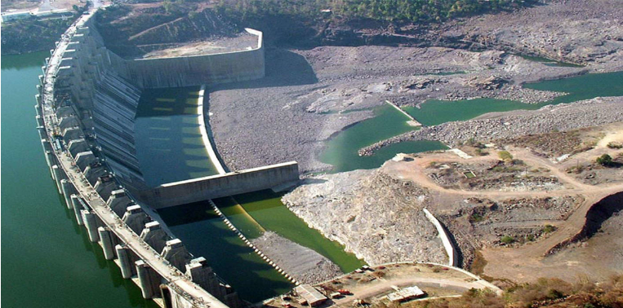
Irrigation Project(National Project)
Project Name: Polavaram Irrigation
Sector: Water Resources
Sub Sector: Irrigation
State: Andhra Pradesh
Project Date: 08 Nov 2004
Completion Date: 31 Mar 2026
Ministry: Department of water Resources
River Development & GR
Canal: 391.14 Km
Dam: 194.6 thousand million cubic ft
Project Scheme: Godavari Diversion Scheme
Land Area: 54248.45 acres
Ticket Size: 55548.87 inr Crores
This project under construction across the Godavari River is located in West Godavari and East Godavari Districts in Andhra Pradesh state and its reservoir spreads in parts of Telangana, Chhattisgarh and Odisha States also. It envisaged to create an irrigation potential of 7.20 lakh Acres for the up land areas of East Godavari & Visakhapatnam Districts.
The project also includes the construction of a hydropower plant to generate electricity using the water stored in the reservoir. The project also envisages generation of 960 MW of hydro power, 23.44 TMC drinking water supply to a population of 28.50 lakh in enroute 611 villages and diversion of 80 TMC of water to Krishna River basin.

Slide 20
Bullet Train
Project Name: Delhi – Varanasi High Speed Rail
State: Delhi
Ticket Size: 1.21 lakh inr Crore
Line Length: 958 Km
Developed by: National High Speed Rail Corporation Limited
Completion Date: 2031
Delhi–Varanasi High Speed Rail Corridor (Delhi–Varanasi HSR) is India's second High-speed rail project after the Mumbai-Ahmedabad High Speed Rail Corridor. The 958-kilometre (595 mi) HSR corridor will connect Varanasi to Delhi through 13 stations along with a 123 km long spur connecting Lucknow and Ayodhy
This line is part of the Diamond Quadrilateral project and will be extended in the future to Patna, Bihar and Kolkata, West Bengal.
The project involves collaboration with international partners, particularly Japan, which has extensive experience in high-speed rail technology. The Japanese Shinkansen technology is being considered for this corridor
Work will resume after Lok Sabha Elections.(2024)

Slide 21
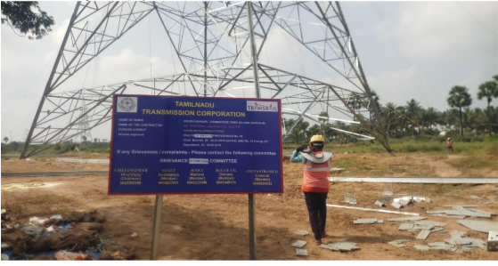
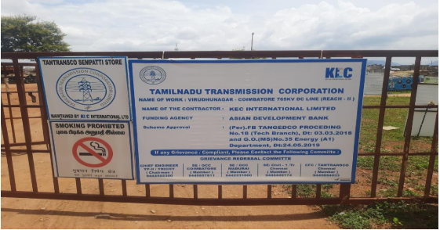
Chennai Power Transmission Project(State project)
Project Name: Chennai-Kanyakumari
Industrial Corridor(CKIC)
Sector: Transmission & Distribution
State: Tamil Nadu
Project date: 01 Apr 2019
Completion Date: 31 Mar 2025
Ministry: Ministry of power
Ticket Size: 51189.44 inr Crores
Substations: 2(7 packages)
Ownership: TANTRANSCO
Type of land: Barren & Dry
CKIC consists of (i) establishment of 765 kV transmission link from the southern section of CKIC (Madurai) to load centers in North (Chennai) and North Western regions of Tamil Nadu.
Output 1: A transmission link from the energy hub in southern CKIC to load centers in northern CKIC established
Output 2: A pooling substation for renewable energy established in southern CKIC. This will establish a pooling substation to receive electricity generated from power
Output 3: Enhanced capacity for improved financial management and gender sensitive workplace

Slide 22
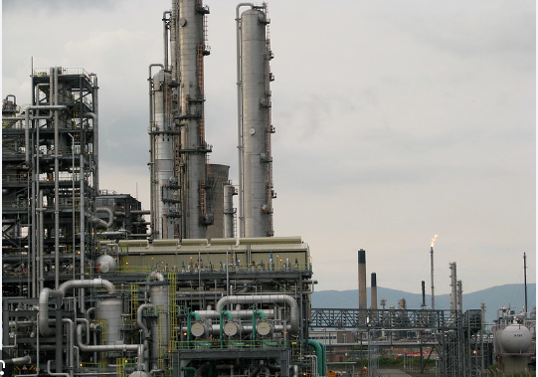
Capacity Expansion of Panipat Refinery(National Project)
Project name: Panipat Refinery and Petrochemical Complex
Sector: Oil & gas
State: Haryana
Project Date: 26 Feb 2021
Completion Date: 31 Dec 2025
Ministry: Ministry of Petroleum & Natural gas
Project Capacity: 615 Km
Ticket Size: 38231 inr Crores
Ownership: Indian Oil Corporation
The project involves the capacity expansion of Panipat
Refinery from 15 MMTPA to 25 MMTPA. The project also
involves installation of Polypropylene unit and
Catalytic Dewaxing Unit.

Slide 23
Panipat Refinery is technically one of the most advanced public sector refinery complexes of India. Commissioned in July, 1998, it is situated in the historic district of Panipat in the State of Haryana.
In August, the company had awarded a contract to McDermott International Ltd to provide a suite of services for further expansions of olefins and polymers production at Panipat refining and chemical complex.
Panipat Refinery is integrated with Aromatic Complex and Naphtha Cracker Complex. Aromatic complex consists of Paraxylene (PX) unit with production capacity of 360 KTPA & Purified Terephthalic Acid (PTA) unit with production capacity of 550 KTPA.
The combined PX-PTA project was set up to produce 360 TMT of Paraxylene per annum and 553 TMT of PTA per annum utilizing Naphtha from Mathura and Panipat Refinery. Paraxylene is an intermediate product used to manufacture Polyester.
Panipat Refinery is strategically located to cater the increase in demand of Northern part of India as compared to meeting the demand by sourcing of products from Refineries situated in western part of India
Some of the New process units include Atmospheric and Vacuum Distillation, Diesel Hydrotreater,VGO Hydrotreater, Resid Hydrocracker, INDMAX, Naphtha Hydrotreater, Isomerization unit, Continuous Catalytic Reforming Unit, Hydrogen Generation unit,Propylene Recovery Unit, Petrochemical integration etc.

Slide 24
Mumbai – Ahmedabad High Speed Rail
Project Name: MAHSR
State: Maharashtra
Project start Date: April 2020
Completion Date: 2027
Developed BY: The National High-Speed Rail Corporation Limited (NHSRCL)
Line Length: 508.18Km
Mumbai – Ahmedabad High-Speed Rail (MAHSR Bullet Train) project is a 508.17 km under construction High Speed Rail line that will connect Mumbai, Maharashtra with Ahmedabad, Gujarat through 12 stations at an estimated cost of Rs. 1.1 lakh crore (US$15 billion).
The project is being executed by the National High Speed Rail Corporation Ltd. (NHSRCL) through a 50-year ₹88,087 crore (US$12 billion) loan from Japan at an interest rate of 0.1%, with repayments scheduled to start 15 years after the line becomes operational.
Trains on the line will operate at a speed of 320 kmph on an elevated viaduct 10-15m above the ground except in Mumbai where the line will be built underground using 3 mega Tunnel Boring Machines (TBM). Between Mumbai and Thane stations, the line will run under the sea at Thane Creek for roughly 2 km
The project’s foundation stone was laid by the prime ministers of India and Japan on September 14, 2017 after which construction work commenced for a 4000-employee High-Speed Rail Training Institute (HSRTI) in Vadodara

Slide 25
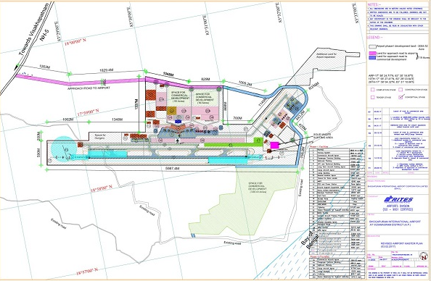
International Airport
Project Name: Bhogapuram Airport
Sector: Aviation Infrastructure
State: Andhra Pradesh
Project Date: 14 Dec 2023
Completion Date: 13 Dec 2026
Land area: 2203.26 acres
Ticket Size: 4727 inr Crores
Developed by: Larsen & Toubro
GMR Visakhapatnam International Airport Limited (GVIAL), a subsidiary of GMR Airports Limited (GAL), is developing a Greenfield International Airport at Bhogapuram, Vizianagaram in Andhra Pradesh. This Airport Project is based on the Public Private Partnership (PPP) model
The proposed GreenField airport site lies on the border of Visakhapatnam and Vizianagaram districts, and is approximately 45 km from Visakhapatnam through NH-16 (Old NH-5) and 25 km from Vizianagaram via NH-43.
Currently, one 3800m long runway of 12L / 30R orientation is being planned along with MRO facilities.
A pre-bid meeting was held in August 2018, for which 13 developers showed interest in developing this airport. The government finally approved the GMR Group,^{[12]} who also operates the international airports of Indira Gandhi International Airport at New Delhi and Rajiv Gandhi International Airport at Hyderabad.

Slide 26
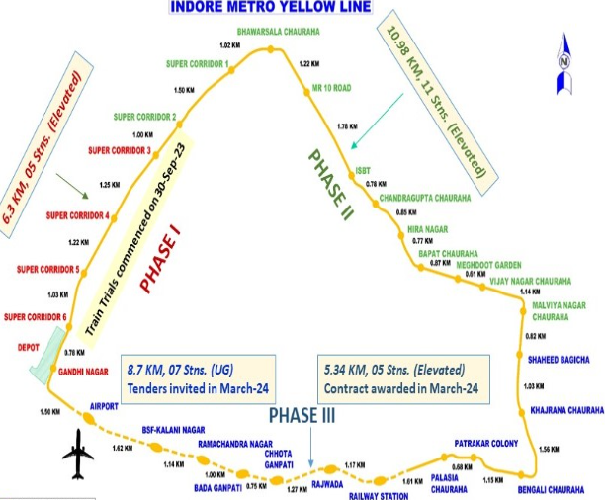
Metro Rail Project(State Project)
Project Name: Indore Metro
Sector: Urban Public transport
State: Madhya Pradesh
Project Date: 30 Nov 2018
Completion Date: 31 Dec 2026
Ministry: Ministry of Housing & Urban affairs
Ticket Size: 7500.8 inr Crores
Number of lines: 1(Yellow Line)
Land Area: 94 Km
Number of Station: 29(16 Under construction 13 approved)
Ownership: Madhya Pradesh Metro Rail Co Limited
System Specs: 80 Top speed,Track gauge-1435mm
electrification-750 V DC third Rail

Slide 27
Indore Metro’s master plan with 94 kms of routes was prepared by Rohit Associates Cities & Rails Pvt.Ltd and envisions 4 metro lines & 2 spurs criss-crossing the city out of which 1 line (Yellow Line / Line-3 – a ring line) has been selected for implementation in Phase 1.
The total system consists of 11 corridors (lines) covering a distance of 124 kilometres (77 mi). This project will cost approximately ₹12,000 crore (US$1.5 billion).
Indore Metro’s Phase 1 project’s Detailed Project Report (DPR) with 33.53 km of routes was approved by the state government in December 2016.
The metro system will be elevated, underground and on ground.^{[2]} The Indore Metro project has been subject to serious contestation due to the inappropriate shifting of Seismic zone-II.
The project was originally planned to be partly funded through an official development assistance (ODA) loan from the Japan International Cooperation Agency (JICA), but will now be funded by the Asian Development Bank (ADB) for an undisclosed amount and New Development Bank (NDB) for $225 million.

Slide 28
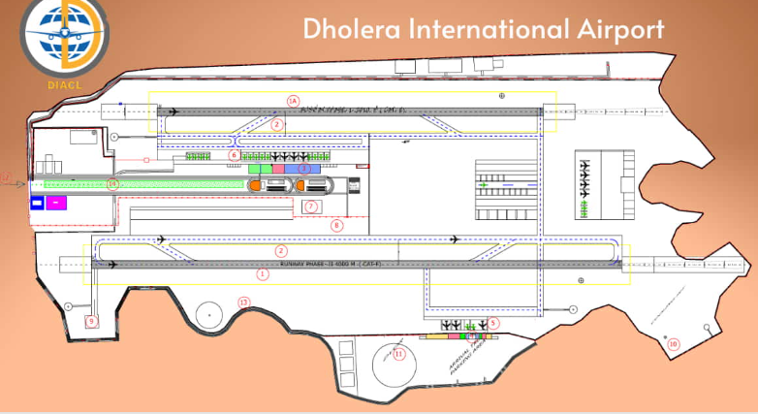
Development Of Dholera International Greenfield Airport
Project name: Dholera Airport
Sector: Aviation Infrastructure
State: Gujarat
Project start date: 28 Jul 2022
Completion Date: 31 Dec 2025
Partner Name: M/s Varaha Infra Limited
Land area: 1501 hecares
Ticket Size: 1305 inr Crores
Dholera International Airport is an under-construction international airport and a greenfield airport, which will serve the Dholera Special Investment Region (DSIR) in Gujarat. It is being built near Navagam in the Dholera taluka of Ahmedabat District. The project site is spread over 1,426 hectares about 80 km (50 mi) from Ahmedabad and around 20 km (12 mi) from the Dholera Special Investment Region (DSIR).75 hectares of government land has been allocated for commercial development.
The project’s owner DIACL is a joint-venture of Airports Authority of India (AAI), Government of Gujarat (GoG) and National Industrial Corridor Development and Implementation Trust (NICDIT) holding equity in the ratio of 51:33:16.
The airport would serve the logistics requirements of the DSIR, which is planned as a huge industrial township in the Delhi Mumbai industrial corridor (DMIC) project, as well as to relieve congestion of the existing Sardar Vallaabhbhai Patel International Airport.

Slide 29
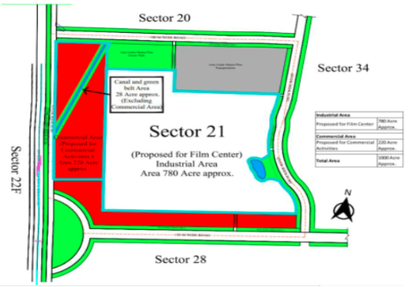
Construction And Development Of Film City(National Project)
Project Name: Bayview Projects
Sector: Real Estate
State: Uttar Pradesh
Project Date: 01 Dec 2023
Completion Date: 01 Dec 2033
Project type: Industrial Park
Ticket Size: 7210 inr Crores
Developer Name: LLP and Bhutani group
Land area: 800 acres
Phases: 3
The Uttar Pradesh government has handed over the “letter of award” for the construction, maintenance and operation of the International Film City project to the consortium led by Bollywood filmmaker Boney Kapoor’s firm Baywatch Projects LLP.
UP Chief Minister Yogi Adityanath’s ambitious International Film City will be developed in sector 21 along the Yamuna Expressway near Noida International Airport.
The development of the first phase of International Film City in Noida is expected to generate direct and indirect employment for 10,000 people. In the 230-acre land parcel, a proposed layout has been allocated for filming facilities, post-production facilities, hospitality, retail, and food and beverage development.

Slide 30
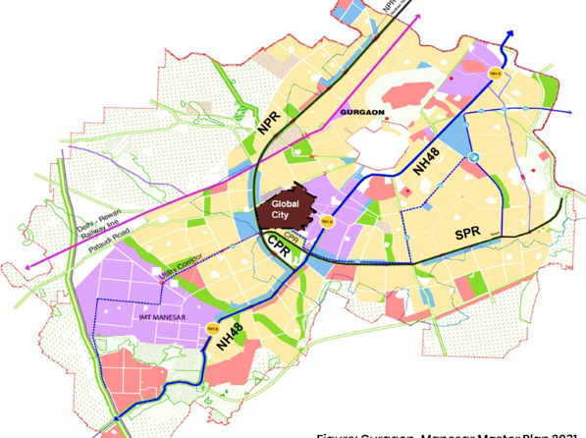
Global City Project [Phase-I] (State Project)
Project Name: Global City Gurugram
Sector: Real Estate
State: Haryana
Project Date: 15 Jul 2024
Completion Date: 15 Jul 2028
Ministry: Ministry of Road & Highways
Ticket size: 758 inr Crores
Land Area: 1002.36 acres(12.88 million build up area)
Developer: Haryana State Industrial and Infrastructure
Development Corporation (HSIIDC)
The project is being executed by the Haryana State Industrial and Infrastructure Development Corporation (HSIIDC). The HSIIDC’s Global City is coming up in Gurugram sectors 36B, 37A and 37B near the recently opened Dwarka Expressway.
The first phase will be completed by December 2026 and will cost ₹940 crore. The project will cover 1,000 acres and will feature commercial towers, offices, retail spaces, hospitals, schools, and a transportation system.
The state government increased HSIIDC’s working capital limit for developing infrastructure in the Global City and IMT Sohna by ₹1,500 crore, a government spokesperson said.

Slide 31
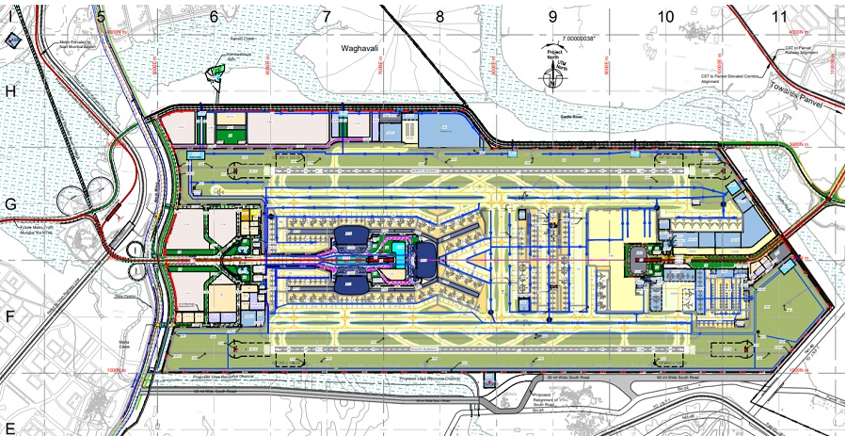
Navi Mumbai International airport (National Project)
Project Name: D.B. Patil International Airport
Sector: Aivation Infrastructure
State: Maharashtra
Project Date: 08 Jan 2018
Completion Date: 10 Jan 2032
Ministry: Ministry of Civil Aviation
Passenger Capacity: 90 million
Serves: Mumbai metropolitian region
Cargo Capacity: 2.5 million tons
Ownership: Cidco(26%),Mial(74%)
Ticket Size: 16,700 inr Crores
Land area: 1160 Hectares

Slide 32
Navi Mumbai International Airport (IATA: NMI, ICAO: none), officially named as D. B. Patil International Airport, is an international airport being constructed in Ulwe, Navi Mumbai, Raigad district, Maharashtra, India. it will become the second airport of the Mumbai Metropolitan Region.
It will be expanded to its final capacity of third phase to handle more than 90 million passengers and 2.5 million tonnes of cargo per annum, by 2032.
L&T Infrastructure Engineering Limited is the detailed design consultant for the project. CIDCO appointed Rail India Technical and Economic Service (RITES) to prepare the masterplan of the airport. The Texas-based Jacobs Engineering Group, prepared a detailed terminal area and facilities model to define the size of the terminals
The ₹16,700 crore (US$2.1 billion) project is being executed by Navi Mumbai International Airport Limited (NMIAL), a special-purpose vehicle formed by the Adani Airports Holdings Limited and CIDCO, which will hold 74% and 26% equity shares of NMIAL respectively.CIDCO will build the project through a public–private partnership (PPP) model on a Design, Build, Finance, Operate, and Transfer (DBFOT) basis. The airport covers an area of 1,160 ha (4.5 sq mi).
It will be connected with Navi Mumbai Metro Line 1 and the proposed Mumbai Metro Line 8 (Gold Line). The airport is also planned to be the terminal station of the proposed Mumbai-Hyderabad High-Speed Rail (HSR) corridor

Slide 33
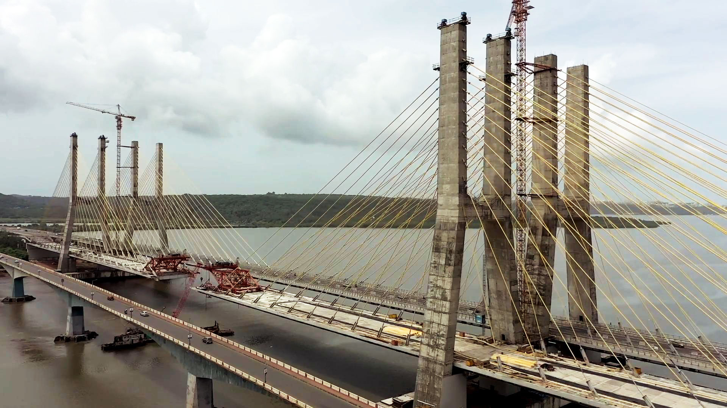
Construction Of Observatory Towers & Viewing Galleries For New Zuari Bridg(State Project)
Project name: Zuari Observatory Towers
Sector: Tourism,Hospitality & wellness
State: Goa
Project Date: 01 Aug 2023
Completion Date: 31 Jul 2028
Ministry: Ministry of tourism
Ticket Size: 270.07 inr Crores
Developed by: Dilip Buildcon limited
This Project Includes engineering and structural
design preparation, Construction of Observatory
Towers & Viewing Galleries including approaches,
decorative lighting, parking and minor bridges,
culverts, road intersections, interchanges, drains,
site development, construction & procurement,
operation & maintenance, etc.

Slide 34
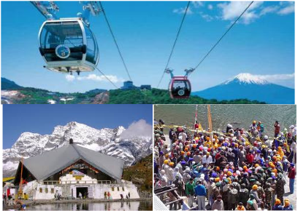
Development, Operation And Maintenance Of Ropeway of Govind Ghat(State Project)
Project Name: Hemkund Ropeway Project
Sector: Tourism,Hospitality & Wellness
State: Uttarakhand
Project Date: 31 Jul 2023
Completion Date: 31 Jul 2026
Ministry: Ministry of road transport & Highways
Land area: 27.02 Hectares
Developed by: FIL Industries
Ticket Size: 967.9 inr Crores
Ropeway Capacity: 6000-8000 Passengers
Main Drive Motor: 2500 KW
DG sets: 4x750 kva and 1x200 kva
Uttarakhand Infrastructure Project Company Private Limited has been mandated to develop the said project on Public Private Partnership format for Uttarakhand Tourism Development Board , GoU. The project is proposed to be developed in 2 phases.
The way from Govind Ghat to Hemkund Sahib is a 19 km steep and tough foot track and takes about 12 hours to reach the Shrine. There is a steep rise in elevations starting from 6000 ft. at Govindghat to 10,000 ft. at Ghangharia and reaching to 15,000 ft. to Hemkund Sahib. The time of travel from Govindghat to Hemkund Sahib will reduce from 12 hours to about 1.5 hours by the proposed ropeway.
The tourist traffic statistics of 2002-2012 indicates that the cumulative annual growth rate of tourists (both domestic and foreigners) visiting Shri Hemkund Sahib have been in the range of 2.8% in the last 10 years i.e. since 2002. Many of the willing people could not visit Hemkund Sahib due to the strenuous trek or steps which will now be convenient for them due to the ropeway.

Slide 35
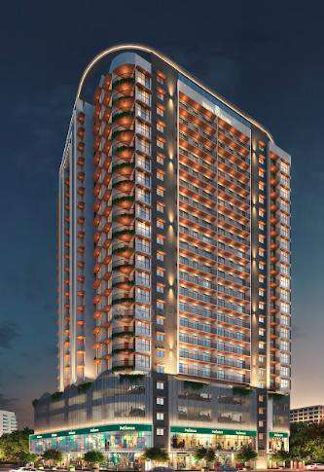
Residential Projects
Project Name: Sigma Passcode Revolution
State: Maharashtra(malad east)
Land area: 1.5 acres
Develeped by: Sigma Group
Total units: 350(4 buildings)
Unit Configuration: 1,2,3 bhk
Possession Date: Feb 2027
Price range: 89 lac minimum price
Size: 1bhk(400 sq.ft),2bhk(555 sq.ft),3bhk(800 sq.ft)
Sigma Passcode Revolution is an impressive residential project located in Malad East, Mumbai. Developed by the renowned Sigma Group, the project spans 1.50 acres, comprising four buildings with a total of 350 meticulously designed units. The unit configurations available include 1 BHK, 2 BHK, and 3 BHK options, catering to the diverse needs of potential residents. With a minimum price starting at Rs. 99 Lakhs, Sigma Passcode Revolution offers an array of choices for homebuyers looking for grand and spacious living spaces.
The project highlights luxury living, featuring over 36 extravagant amenities to enhance residents' lifestyles. Strategically located, Sigma Passcode Revolution offers easy access to essential facilities and services. This development reflects Sigma Group's commitment to delivering quality homes with a modern living focus.

Slide 36
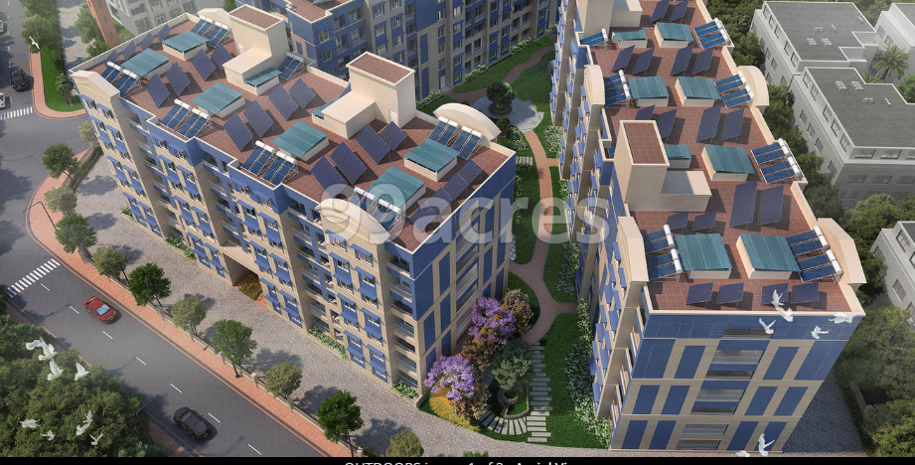
Project Name: Brigade Xanadu
State: Tamil Nadu
Sub area: Mogappair, Chennai
Developed by: Brigade Group
Land Area: 33 acres
Possession: Dec 2026
Unit Configuration: 1,2,3,4 bhk
Price range: 57.03 lac-2.36 cr
Units: 1840(11 towers)
Brigade Xanadu in Mogappair, Chennai North by Brigade Group is a residential project.
The project offers Apartments with perfect combination of contemporary architecture and features to provide comfortable living.
The project is spread over a total area of 33.65 acres of land. It has 60% of open space. Brigade Xanadu has a total of 11 towers. The construction is of 6 floors. An accommodation of 944 units has been provided. Offering 35 amenities for better living experience.

Slide 37
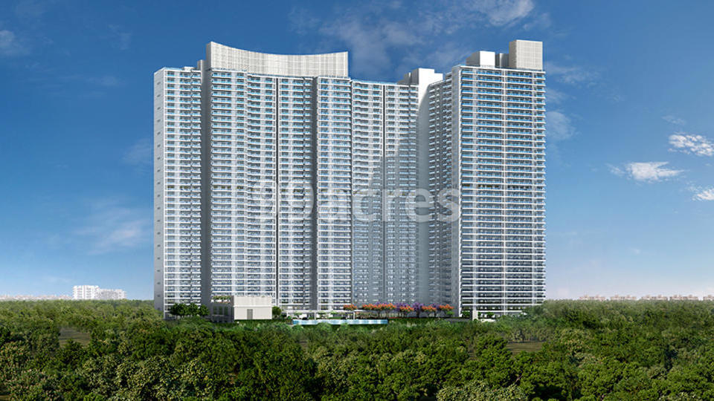
Project Name: DLF One Midtown
State: Delhi
Sub area: Moti nagar,west delhi
Land area: 128 acres
Units: 913(4 towers)
Developed by: DlF Builders
Unit Configuration: 2,3,4 Bhk
Price range: 4.2cr-11cr
Possession: Jul 2026
Area range: 1731 Sq.ft-3300 sq.ft
DLF One Midtown is an ultra-modern luxurious residential project newly launched in the heart of New Delhi at Moti Nagar.Spread over an area of acres and lodged in the lap of picturesque lush green surroundings.
The project hosts four exquisite towers with interconnected terraces, a lavish resort-themed clubhouse, and a green area with sports amenities
Moti Nagar is a bustling residential locality surrounded by Kirti Nagar, Rajouri Garden, and Punjabi Bagh. It is a sought-after locality for its well-developed infrastructure and connectivity to neighboring employment hubs like Bhikaji Cama Place, Connaught Place, Noida.

Slide 38
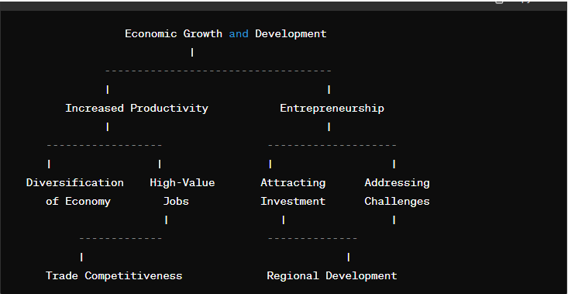
Impact on economic growth and development

Slide 39
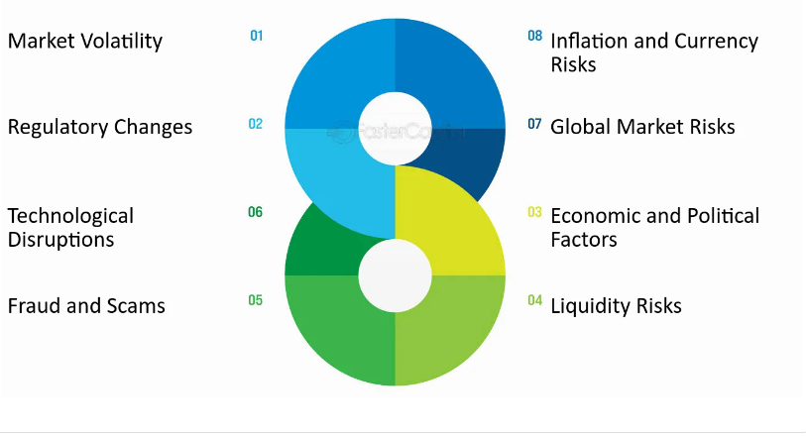
Potential challenges in government investment

Slide 40


